Slide 1
Grigori Perelman
Russian mathematician

Slide 2
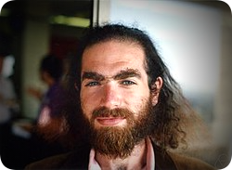
Formation of a scientist
1982 - Victory in the International Mathematical Olympiad in
Budapest and admission to the Faculty of Mathematics and
Mechanics of Leningrad State University
1987 - Admission to graduate school at the Leningrad
Department of the Mathematical Institute. V. A. Steklova
1990 - PhD thesis defense
1992 - Scientific activity in the USA
1996 - Return to St. Petersburg and start work
on the Poincaré conjecture
Grigori Perelman
13 June 1966

Slide 3
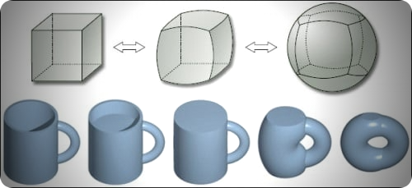
Poincaré hypothesis
2002 - 2003 - Publication of articles proving
the Poincaré conjecture:
The entropy formula for the Ricci flow
and its geometric applications
Ricci flow with surgery
on three-manifolds
Finite extinction time for the solutions to the Ricci flow on certain three-manifolds

Slide 4
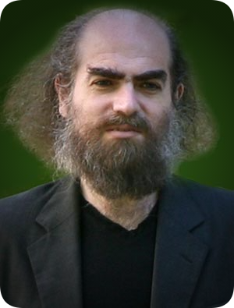
Recognition
2006 - “Fields Medal”
2010 - “Millennium Prize”
2011 - Sponsoring young scientists through
the “Millennium Prize”

Slide 5
Conclusion

